Slide 1

By <CHETAN MATHUR>
Business Analyst Career Program - Internship Project

Slide 2

Agenda
Import the Data into PowerBI
Explaining insights from the Plot/Graph Plotted.
Interactive Dashboard by using visualization tools
Conclusion and Inferences
Endnotes

Slide 3
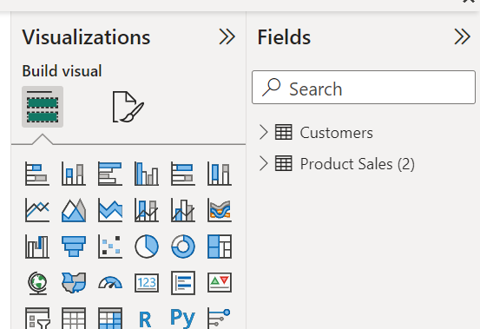
Import the Data into PowerBI
Insert the relevant screenshots verifying that the data is successfully inserted into PowerBI and do the required data cleaning or creation of measured for data analysis

Slide 4
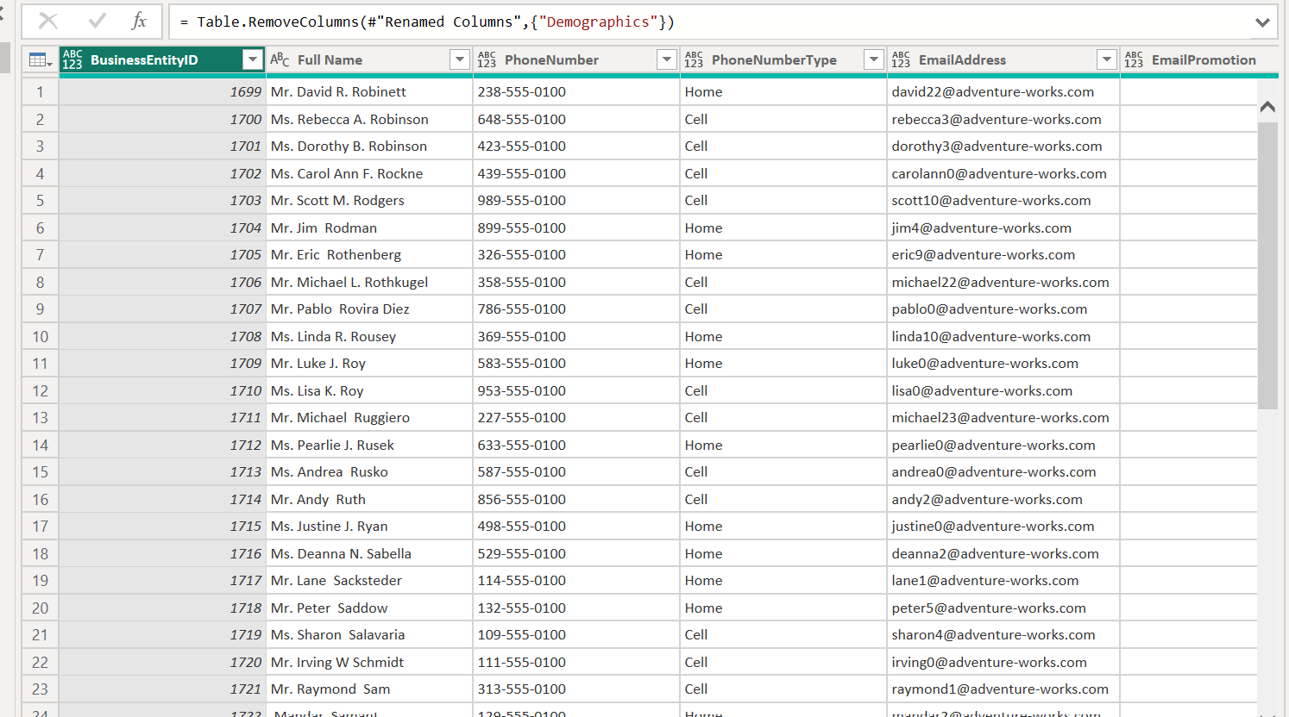
Continue……

Slide 5
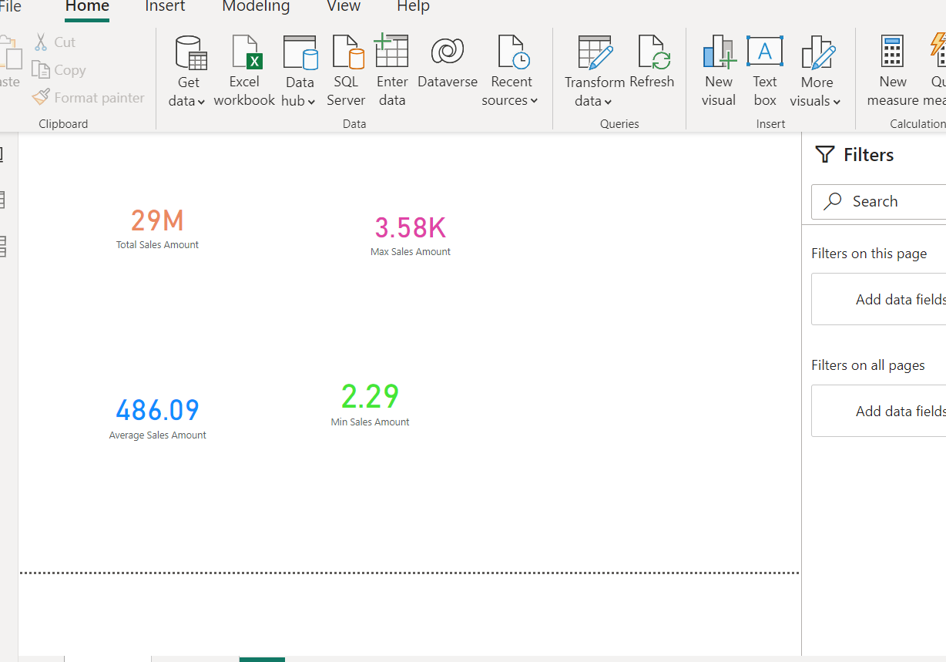
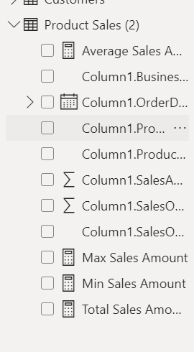
Continue……

Slide 6
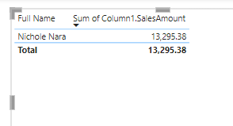
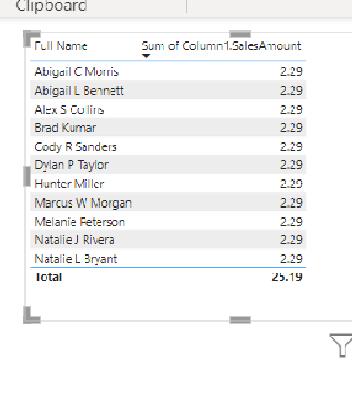
Insights from the Plot/Graph Plotted.
The graph showing the customer name with highest sales amount.
The table on the left shows that 11 customers are there in database with minimum sales amount.

Slide 7
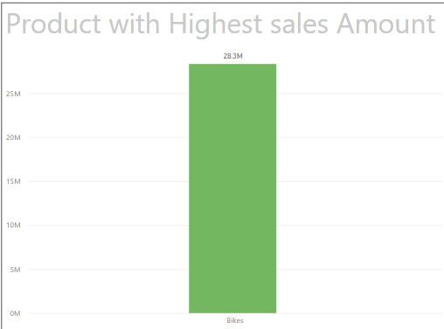
Continue…
The graph on the left shows the product category with highest sales amount

Slide 8
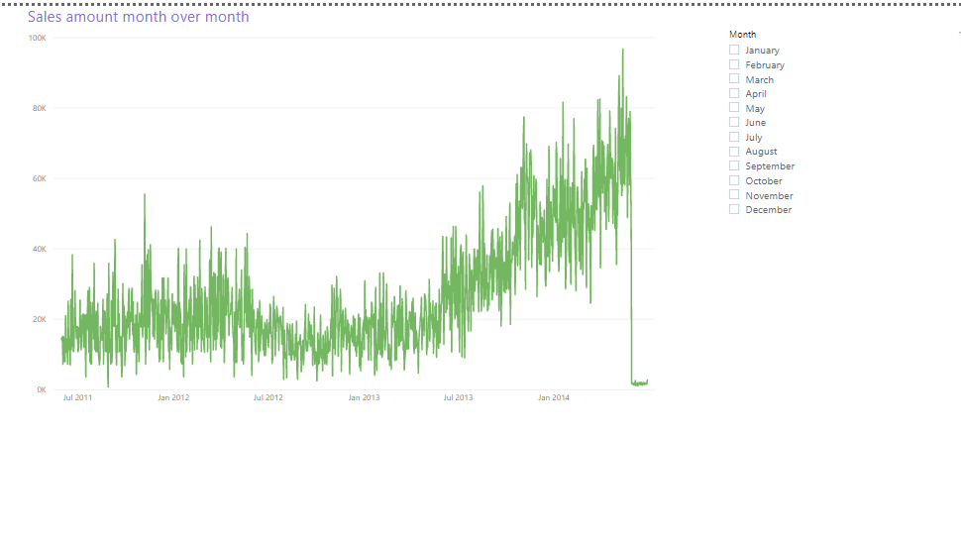
Continue…..
Month over Month sales amount

Slide 9
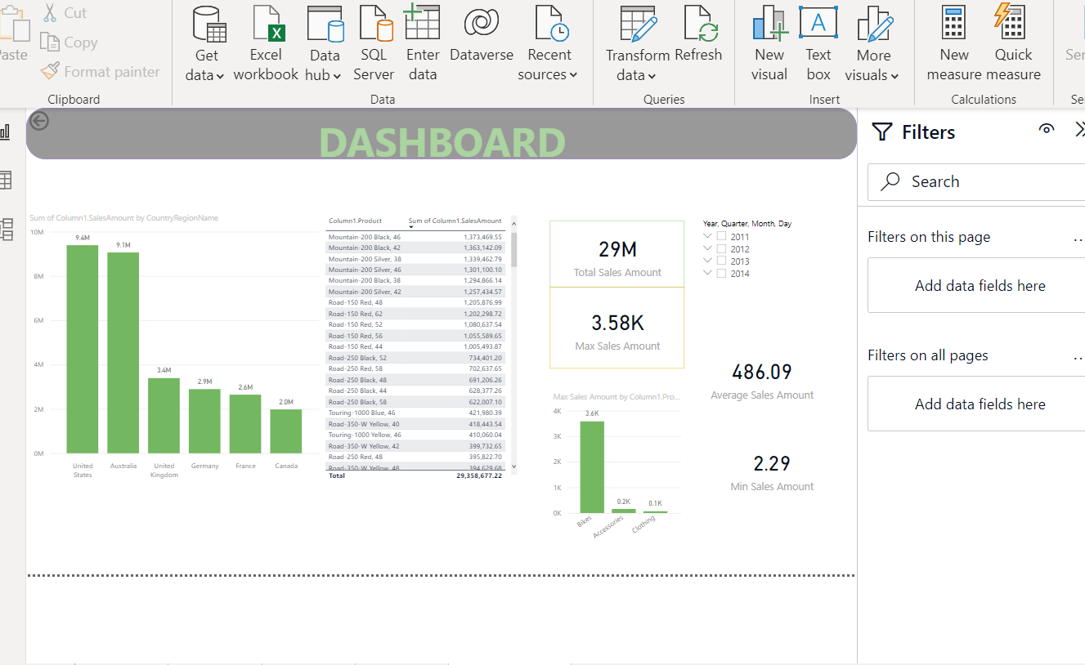
Interactive Dashboard by using visualization tools

Slide 10
Conclusion and Inferences
We have two different kind of data sets i.e. Customer & product Sales data with one common column which acts as primary key to make a link between two tables.
The data is in structured form but cleaning is required.
The Customer data as initially too much dimensions such as first, second, and last name and Address 1 & Address 2 by using Power BI query editor tool we merged the columns so that data appear good.
We have created measures to know the max, min, total, avg sales amount of product.
Then, we have created dashboard to determine the insights of database.
Insights shows that US has highest sales amount (9.4 Million $) among all the countries over the years from 2011 to 2014 in all kind of product categories i.e. ( Bikes, accessories, clothing).
In terms of product category, major proportions of sales amount comes with the sales of bikes and it covers 96.66% of sales amount.

Slide 11
Continue….
The sales amount of bikes is high in Australia from 2011 till 2013 but it decline in 2014 and sales amount of bikes in US is way higher than Australia which results in higher overall sales of America.
Insights shows that overall in all countries, among all bikes, people buy mountain 200-black 46 and mountain 200-black 42 is competitive and holds 2nd rank.
Mountain 500-silver 44 has lowest sales amongst all countries.
Woman mountains shorts with size ,L attract more woman customers and it has higher sales amount.

Slide 12
Endnotes
Kindly check BI file attached below:-
Internship Project.pbix

